Slide 1
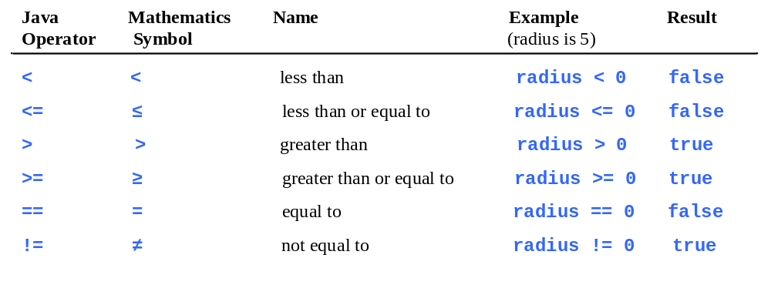
Relational Operators

Slide 2
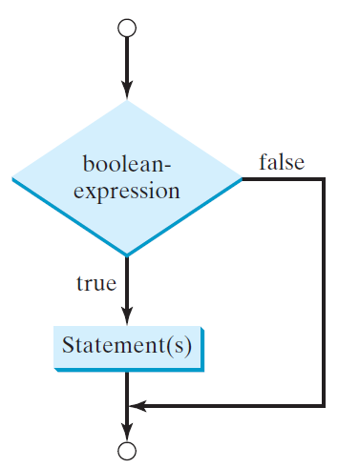
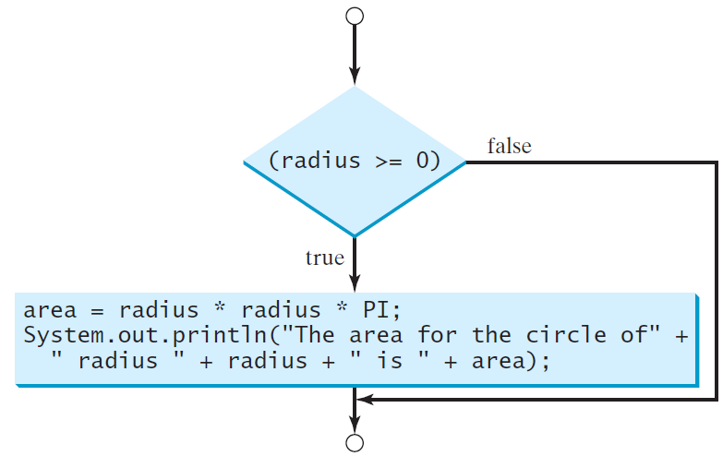
One-way if Statements
if (radius >= 0) {
area = radius * radius * PI;
System.out.println("The area"
+ " for the circle of radius "
+ radius + " is " + area);
}
if (boolean-expression) {
statement(s);
}

Slide 3


Note

Slide 4
Simple if Demo
Write a program that prompts the user to enter an integer. If the number is a multiple of 5, print HiFive. If the number is divisible by 2, print HiEven.

Slide 5
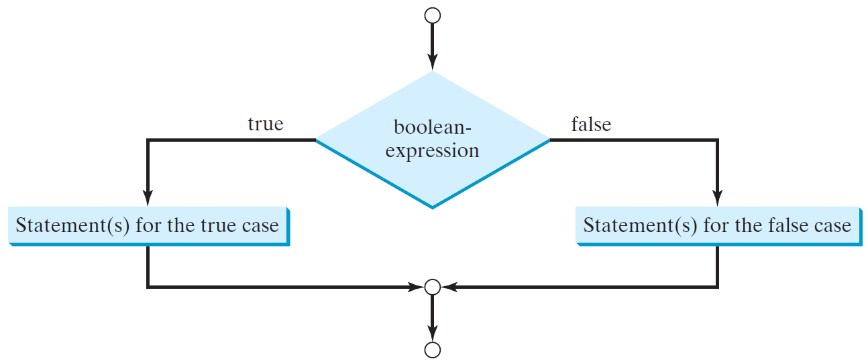
The Two-way if Statement
if (boolean-expression) {
statement(s)-for-the-true-case;
}
else {
statement(s)-for-the-false-case;
}

Slide 6
if-else Example
if (radius >= 0) {
area = radius * radius * 3.14159;
System.out.println("The area for the “
+ “circle of radius " + radius +
" is " + area);
}
else {
System.out.println("Negative input");
}

Slide 7
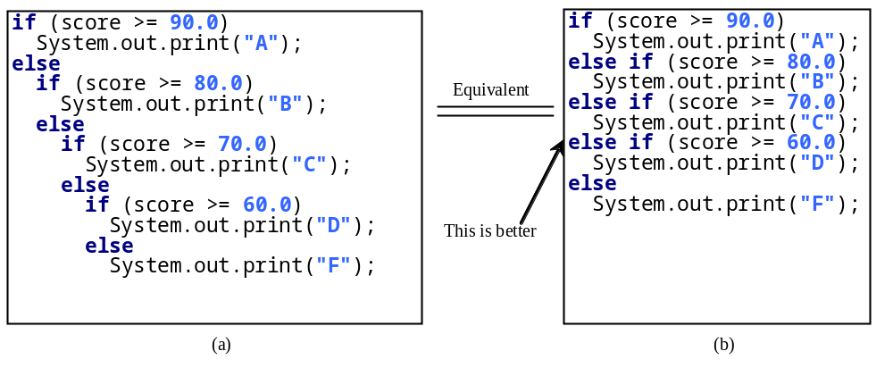
Multiple Alternative if Statements

Slide 8
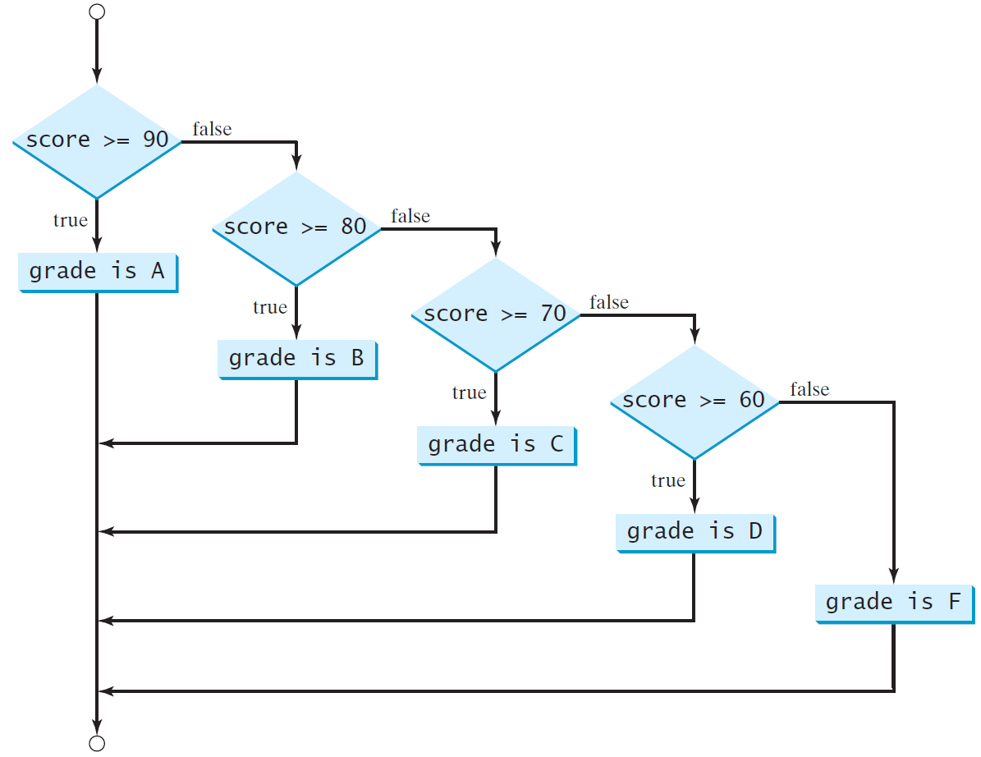
Multi-Way if-else Statements

Slide 9
Trace if-else statement
animation
Suppose score is 70.0
The condition is false
if (score >= 90.0)
System.out.print("A");
else if (score >= 80.0)
System.out.print("B");
else if (score >= 70.0)
System.out.print("C");
else if (score >= 60.0)
System.out.print("D");
else
System.out.print("F");

Slide 10
Trace if-else statement
animation
Suppose score is 70.0
The condition is false
if (score >= 90.0)
System.out.print("A");
else if (score >= 80.0)
System.out.print("B");
else if (score >= 70.0)
System.out.print("C");
else if (score >= 60.0)
System.out.print("D");
else
System.out.print("F");

Slide 11
Trace if-else statement
animation
Suppose score is 70.0
The condition is true
if (score >= 90.0)
System.out.print("A");
else if (score >= 80.0)
System.out.print("B");
else if (score >= 70.0)
System.out.print("C");
else if (score >= 60.0)
System.out.print("D");
else
System.out.print("F");

Slide 12
Trace if-else statement
animation
Suppose score is 70.0
grade is C
if (score >= 90.0)
System.out.print("A");
else if (score >= 80.0)
System.out.print("B");
else if (score >= 70.0)
System.out.print("C");
else if (score >= 60.0)
System.out.print("D");
else
System.out.print("F");

Slide 13
Trace if-else statement
animation
Suppose score is 70.0
Exit the if statement
if (score >= 90.0)
System.out.print("A");
else if (score >= 80.0)
System.out.print("B");
else if (score >= 70.0)
System.out.print("C");
else if (score >= 60.0)
System.out.print("D");
else
System.out.print("F");

Slide 14
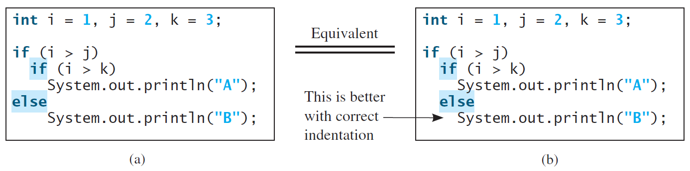
Note
The else clause matches the most recent if clause in the same block.

Slide 15
Note, cont.
Nothing is printed from the preceding statement. To force the else clause to match the first if clause, you must add a pair of braces:
int i = 1;
int j = 2;
int k = 3;
if (i > j) {
if (i > k)
System.out.println("A");
}
else
System.out.println("B");
This statement prints B.

Slide 16
Common Errors
Adding a semicolon at the end of an if clause is a common mistake.
if (radius >= 0);
{
area = radius*radius*PI;
System.out.println(
"The area for the circle of radius " +
radius + " is " + area);
}
This mistake is hard to find, because it is not a compilation error or a runtime error, it is a logic error.
This error often occurs when you use the next-line block style.
Wrong

Slide 17

TIP

Slide 18

CAUTION

Slide 19
Logical Operators
Operator | Name | Description
! | not | logical negation
&& | and | logical conjunction
|| | or | logical disjunction
^ | exclusive or | logical exclusion

Slide 20
Truth Table for Operator !
p | !p | Example (assume age = 24, weight = 140)
true | false | !(age > 18) is false, because (age > 18) is true.
false | true | !(weight == 150) is true, because (weight == 150) is false.

Slide 21
Truth Table for Operator &&
p₁ | p₂ | p₁ && p₂ | Example (assume age = 24, weight = 140)
false | false | false | (age <= 18) && (weight < 140) is false, because (age > 18) and (weight <= 140) are both false.
false | true | false
true | false | false | (age > 18) && (weight > 140) is false, because (weight > 140) is false.
true | true | true | (age > 18) && (weight >= 140) is true, because both (age > 18) and (weight >= 140) are true.

Slide 22
Truth Table for Operator ||
p₁ | p₂ | p₁ || p₂ | Example (assume age = 24, weihgt = 140)
false | false | false
false | true | true | (age > 34) || (weight <= 140) is true, because (age > 34) is false, but (weight <= 140) is true.
true | false | true | (age > 14) || (weight >= 150) is false, because (age > 14) is true.
true | true | true

Slide 23
Truth Table for Operator ^
p₁ | p₂ | p₁ ^ p₂ | Example (assume age = 24, weight = 140)
false | false | false | (age > 34) ^ (weight > 140) is true, because (age > 34) is false and (weight > 140) is false.
false | true | true | (age > 34) ^ (weight >= 140) is true, because (age > 34) is false but (weight >= 140) is true.
true | false | true | (age > 14) ^ (weight > 140) is true, because (age > 14) is true and (weight > 140) is false.
true | true | false

Slide 24
Examples
Here is a program that checks whether a number is divisible by 2 and 3, whether a number is divisible by 2 or 3, and whether a number is divisible by 2 or 3 but not both:

Slide 25
switch Statements
switch (status) {
case 0: compute taxes for single filers;
break;
case 1: compute taxes for married file jointly;
break;
case 2: compute taxes for married file separately;
break;
case 3: compute taxes for head of household;
break;
default: System.out.println("Errors: invalid status");
System.exit(1);
}

Slide 26
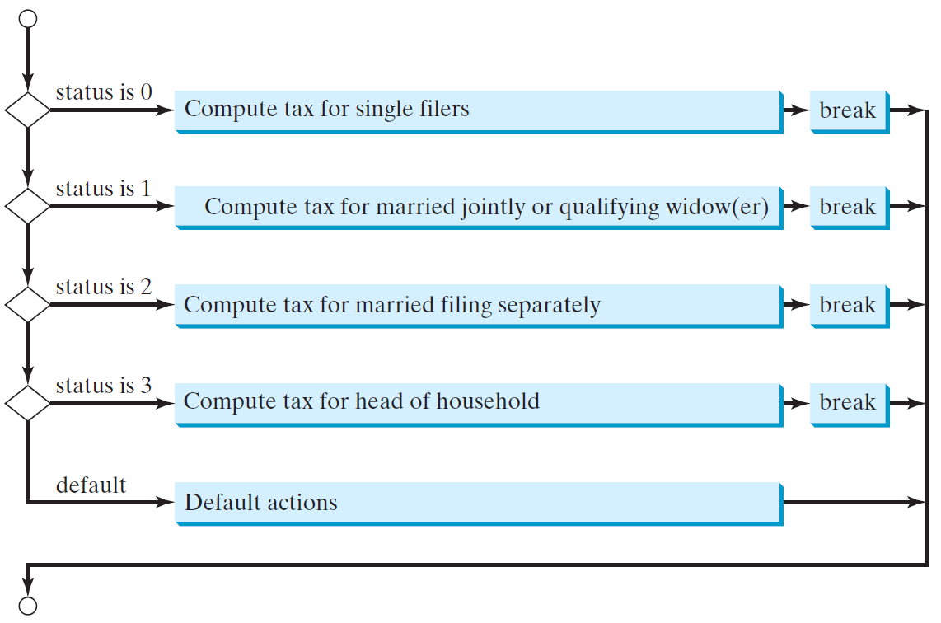
switch Statement Flow Chart

Slide 27
switch Statement Rules
The switch-expression must yield a value of char, byte, short, or int type and must always be enclosed in parentheses.
switch (switch-expression) {
case value1: statement(s)1;
break;
case value2: statement(s)2;
break;
…
case valueN: statement(s)N;
break;
default: statement(s)-for-default;
}
The value1, ..., and valueN must have the same data type as the value of the switch-expression. The resulting statements in the case statement are executed when the value in the case statement matches the value of the switch-expression. Note that value1, ..., and valueN are constant expressions, meaning that they cannot contain variables in the expression, such as 1 + x.

Slide 28
switch Statement Rules
The keyword break is optional, but it should be used at the end of each case in order to terminate the remainder of the switch statement. If the break statement is not present, the next case statement will be executed.
switch (switch-expression) {
case value1: statement(s)1;
break;
case value2: statement(s)2;
break;
…
case valueN: statement(s)N;
break;
default: statement(s)-for-default;
}
The default case, which is optional, can be used to perform actions when none of the specified cases matches the switch-expression.
When the value in a case statement matches the value of the switch-expression, the statements starting from this case are executed until either a break statement or the end of the switch statement is reached.

Slide 29
Trace switch statement
animation
Suppose day is 2:
switch (day) {
case 1:
case 2:
case 3:
case 4:
case 5: System.out.println("Weekday"); break;
case 0:
case 6: System.out.println("Weekend");
}

Slide 30
Trace switch statement
animation
Match case 2
switch (day) {
case 1:
case 2:
case 3:
case 4:
case 5: System.out.println("Weekday"); break;
case 0:
case 6: System.out.println("Weekend");
}

Slide 31
Trace switch statement
animation
Fall through case 3
switch (day) {
case 1:
case 2:
case 3:
case 4:
case 5: System.out.println("Weekday"); break;
case 0:
case 6: System.out.println("Weekend");
}

Slide 32
Trace switch statement
animation
Fall through case 4
switch (day) {
case 1:
case 2:
case 3:
case 4:
case 5: System.out.println("Weekday"); break;
case 0:
case 6: System.out.println("Weekend");
}

Slide 33
Trace switch statement
animation
Fall through case 5
switch (day) {
case 1:
case 2:
case 3:
case 4:
case 5: System.out.println("Weekday"); break;
case 0:
case 6: System.out.println("Weekend");
}

Slide 34
Trace switch statement
animation
Encounter break
switch (day) {
case 1:
case 2:
case 3:
case 4:
case 5: System.out.println("Weekday"); break;
case 0:
case 6: System.out.println("Weekend");
}

Slide 35
Trace switch statement
animation
Exit the statement
switch (day) {
case 1:
case 2:
case 3:
case 4:
case 5: System.out.println("Weekday"); break;
case 0:
case 6: System.out.println("Weekend");
}

Slide 36
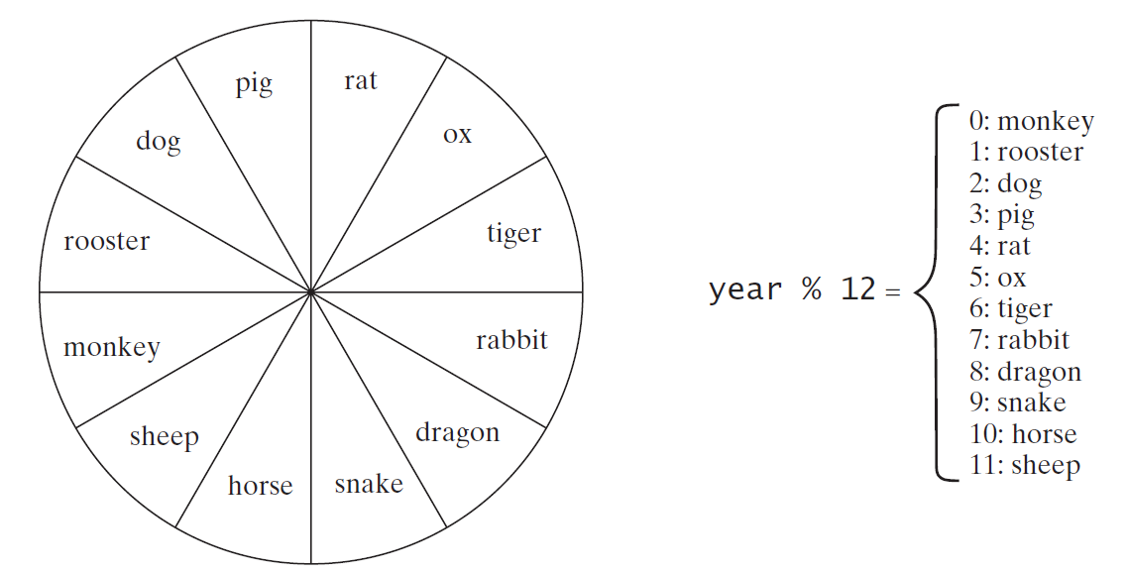
Problem: Chinese Zodiac
Write a program that prompts the user to enter a year and displays the animal for the year.

Slide 37
Operator Precedence
var++, var--
+, - (Unary plus and minus), ++var,--var
(type) Casting
! (Not)
*, /, % (Multiplication, division, and remainder)
+, - (Binary addition and subtraction)
<, <=, >, >= (Relational operators)
==, !=; (Equality)
^ (Exclusive OR)
&& (Conditional AND) Short-circuit AND
|| (Conditional OR) Short-circuit OR
=, +=, -=, *=, /=, %= (Assignment operator)

Slide 38
Operator Precedence and Associativity
The expression in the parentheses is evaluated first. (Parentheses can be nested, in which case the expression in the inner parentheses is executed first.) When evaluating an expression without parentheses, the operators are applied according to the precedence rule and the associativity rule.
If operators with the same precedence are next to each other, their associativity determines the order of evaluation. All binary operators except assignment operators are left-associative.

Slide 39
Operator Associativity
When two operators with the same precedence are evaluated, the associativity of the operators determines the order of evaluation. All binary operators except assignment operators are left-associative.
a – b + c – d is equivalent to ((a – b) + c) – d
Assignment operators are right-associative. Therefore, the expression
a = b += c = 5 is equivalent to a = (b += (c = 5))

Slide 40

Example
Applying the operator precedence and associativity rule, the expression 3 + 4 * 4 > 5 * (4 + 3) - 1 is evaluated as follows:

